Slide 1
Full-Stack Development ga Kirish

Slide 2
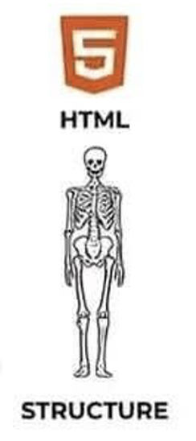
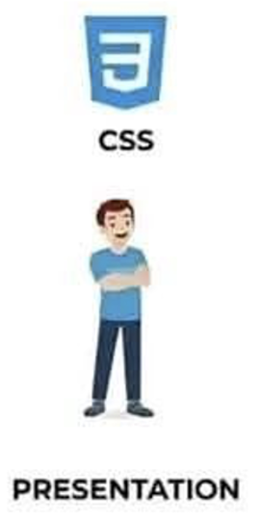


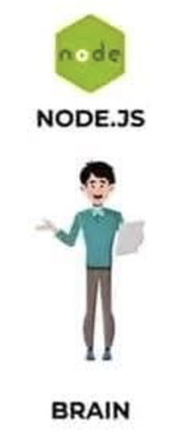
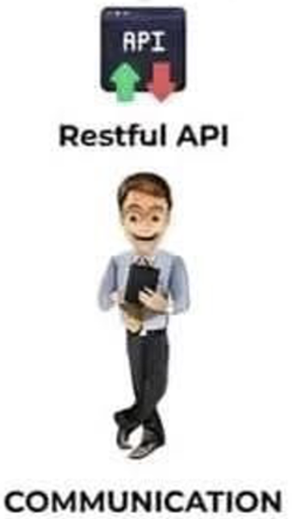


Course Purpose
To equip students with practical Full-Stack development skills, enabling them to create dynamic, robust, secure servers and databases.
By the end of the course, students will:
Understand the frontend-backend relationship
Master JavaScript from basic to advanced levels.
Build and deploy Node.js & Express.js backend applications.
Work with PostgreSQL databases to store and manage data.
Design and consume REST APIs for data exchange.
Implement security best practices in web applications.

Slide 3
Kursning maqsadi
Talabalarga haqiqiy Full-Stack dasturchi bo‘lish uchun zarur amaliy ko‘nikmalarni o‘rgatish: dinamik, ishonchli va xavfsiz serverlar hamda ma’lumotlar bazalarini mustaqil yaratib, ishga tushira olish darajasiga yetkazish.
Kursni tugatgach, talabalar quyidagi natijalarga erishadilar:
• Frontend va backend qanday bir-biri bilan ishlayotganini aniq tushunadilar
• JavaScript-ni noldan professional darajagacha mukammal egallaydilar
• Node.js + Express.js bilan to‘liq ishlaydigan backend serverlar qurib, ularni onlayn joylashtirishni o‘rganadilar
• MySQL ma’lumotlar bazasida ma’lumotlarni saqlash, o‘zgartirish va samarali boshqarishni biladilar
• REST API-larni yaratish va ulardan foydalanish tajribasiga ega bo‘ladilar
• Veb-dasturlarda xavfsizlikni ta’minlashning asosiy usullari va eng yaxshi amaliyotlarini qo‘llay oladilar

Slide 4



Course Schedule and Rules
3 lectures per week - 80 minutes per lecture
1 lectures Theory
2 lectures Practise
Attending classes on time and be active
Completing homework on time without cheating
Do not play games and sleep during class

Slide 5
Dars jadvali va qoidalar
Haftada 3 dars - 80 daqiqadan
1 maruza, nazariya
2 seminar, amaliyot
Darslarga o‘z vaqtida kelish va faol ishtirok etish
Uy vazifalarini o‘z vaqtida, hech qanday ko‘chirishsiz (aldovsiz) bajarish
Dars vaqtida o‘yin o‘ynamaslik va uxlamaslik

Slide 6
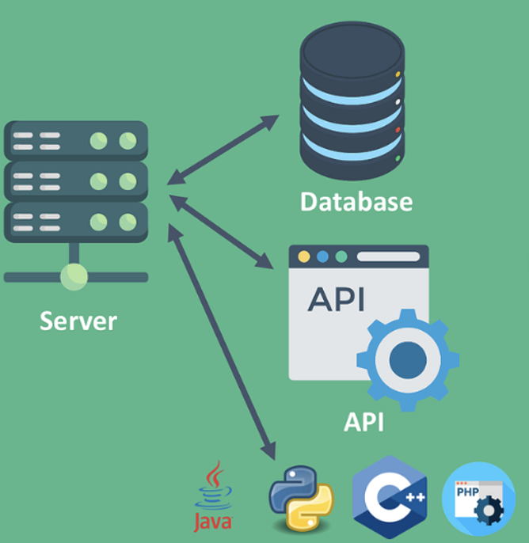
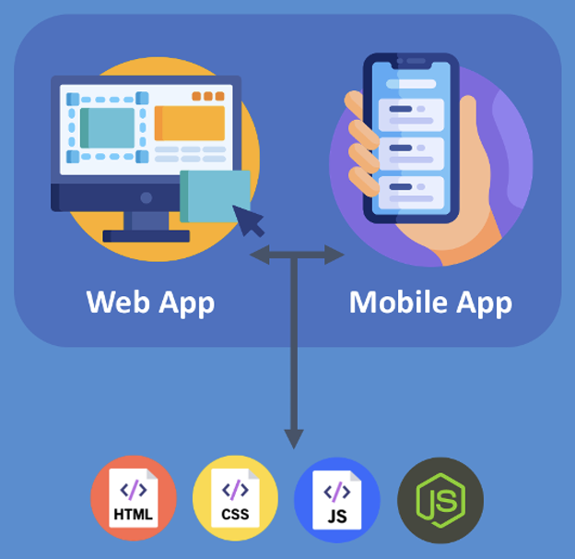



What is Full-Stack Development?
Full-stack development refers to the ability to work on both the frontend (client-side) and backend (server-side) of an application.
Responsibilities of a Full-Stack Developer:
Building user interfaces (Frontend)
Developing server-side logic (Backend)
Managing databases (Database)
Working with APIs and network requests

Slide 7
Full-Stack Development nima?
Full-stack dasturlash (yoki full-stack development) — bu ilova (veb-sayt yoki mobil ilova) ning ikkala tomonini ham — frontend (foydalanuvchi tarafi, client-side) va backend (server tarafi, server-side) ni birdek ishlab chiqish va boshqara olish qobiliyatidir.
Full-Stack dasturchining mas'uliyatlari:
Foydalanuvchi interfeyslarini (Frontend) yaratish va loyihalashtirish
Server tomonidagi logikani (Backend) ishlab chiqish va boshqarish
Ma’lumotlar bazalarini (Database) boshqarish, loyihalashtirish va optimallashtirish
API-lar bilan ishlash va tarmoq so‘rovlarini (network requests) amalga oshirish

Slide 8
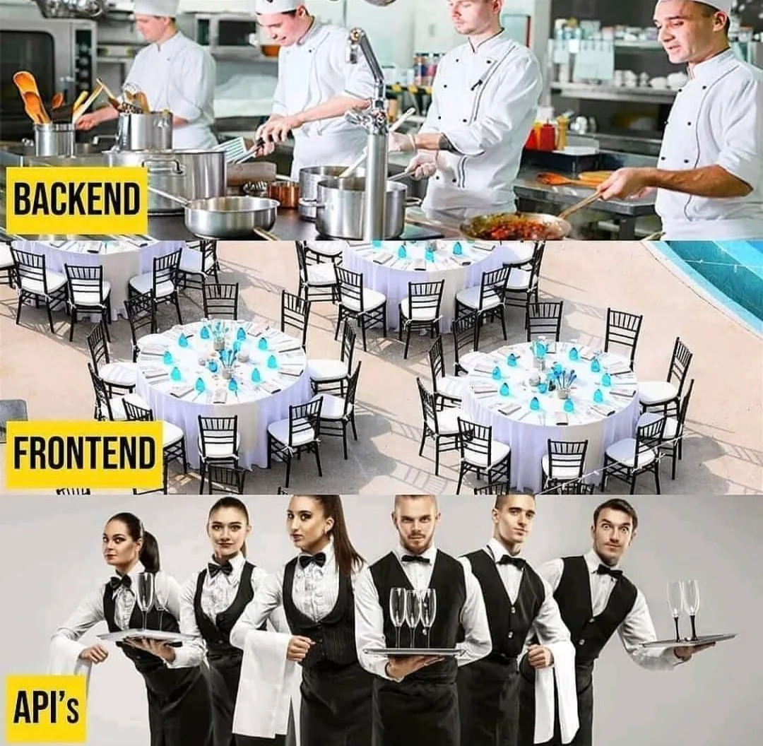
Visualization and Analogy
Making all hard stuff at the back of the restaurant
Looks nice to costumers and everything on the order
Helpers who can bring dishes in front of you

Slide 9
Vizualizatsiya analogiya
Oshxonada oshpazlar taom tayyorlashadi
Mijozlar buyurtma beradi va ularni qabul qilib oladilar
Girgitton(ofitsant) buyurtmalarni olib yetkazadilar

Slide 10
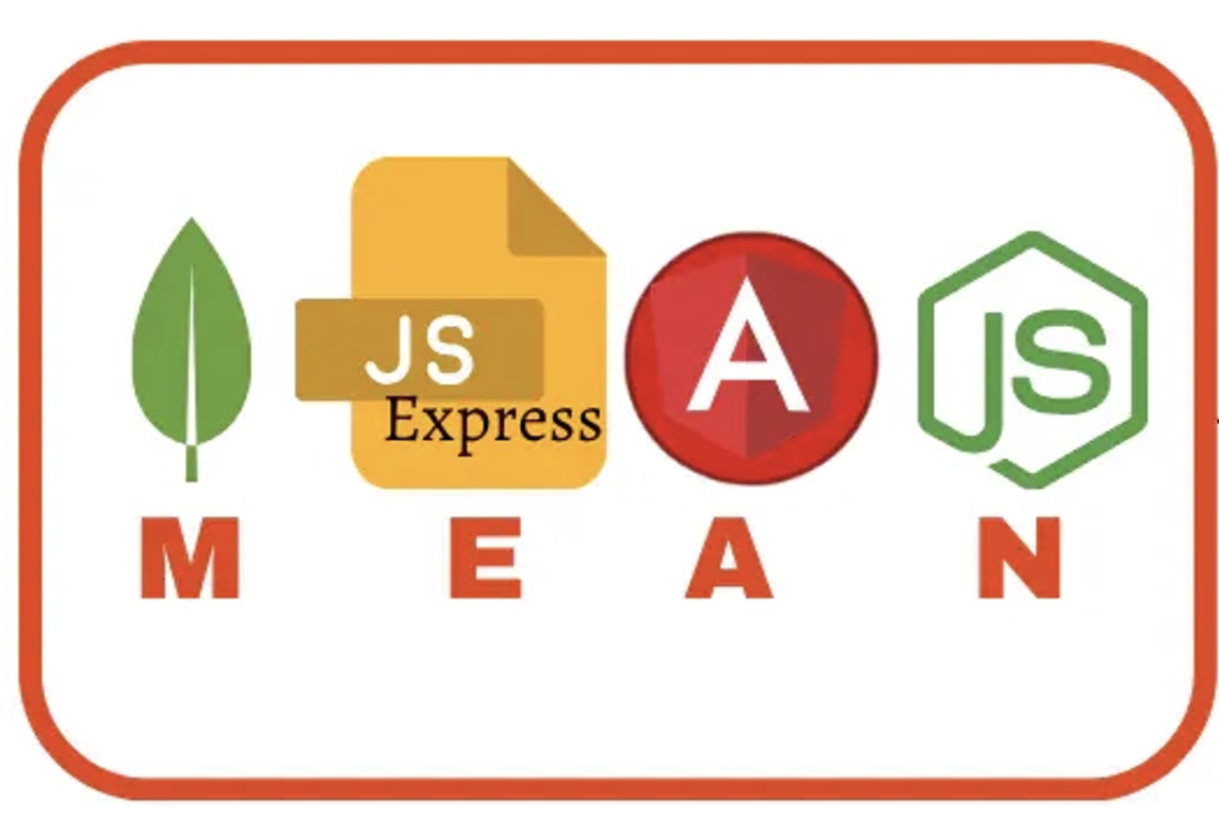
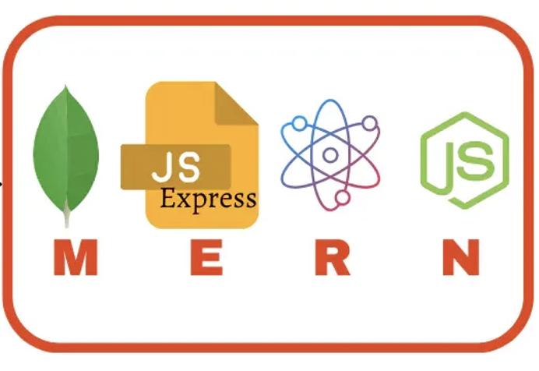
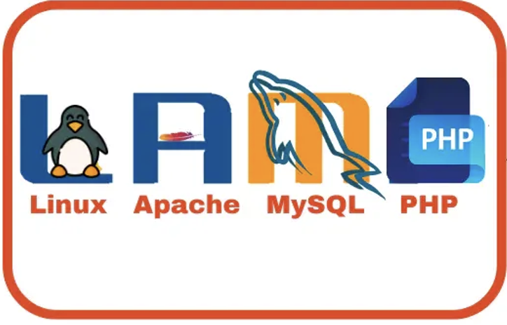
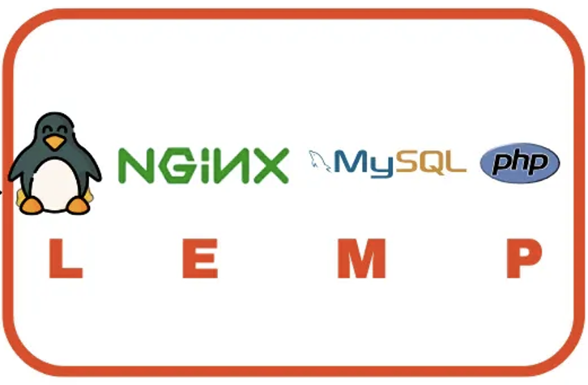
Stack turlari

Slide 11
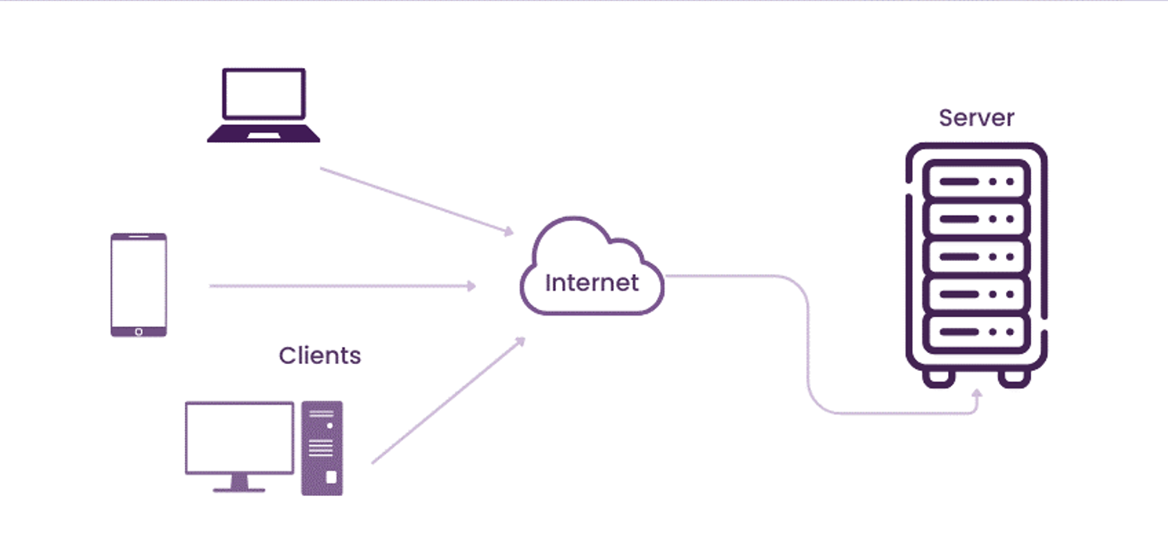
Client-Server Arxitekturasi

Slide 12
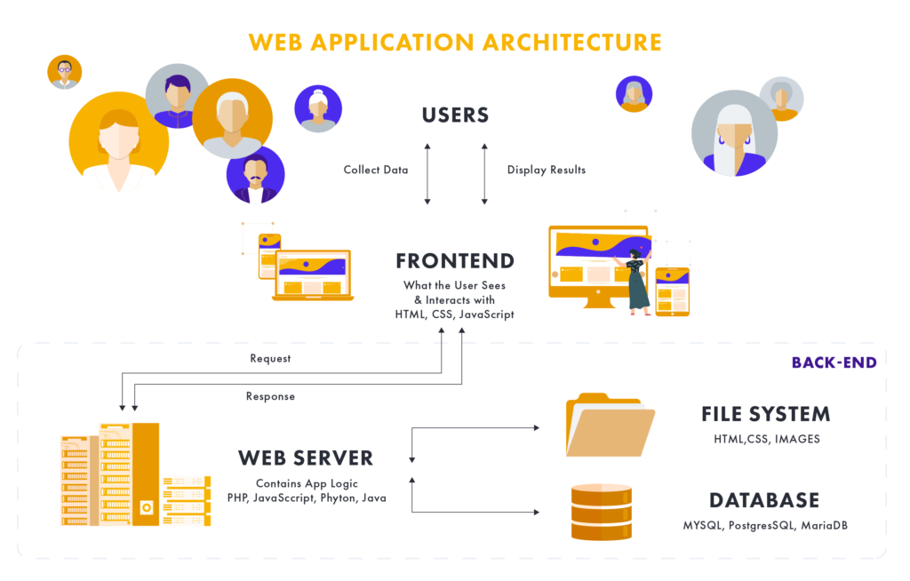
Client-Server Architecture

Slide 13
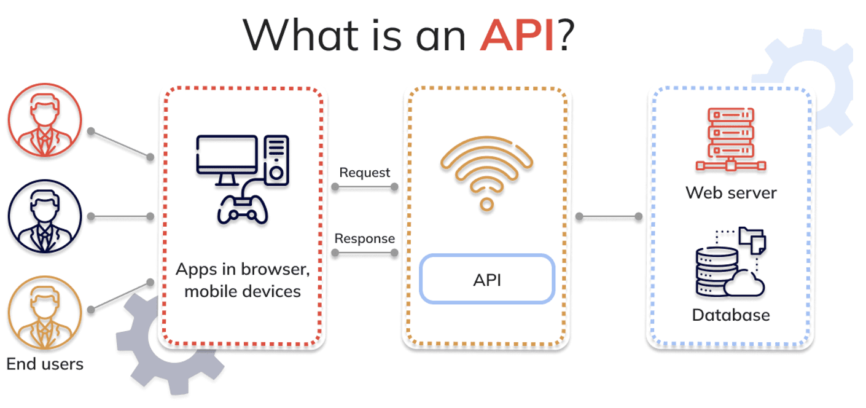
Understanding APIs

Slide 14
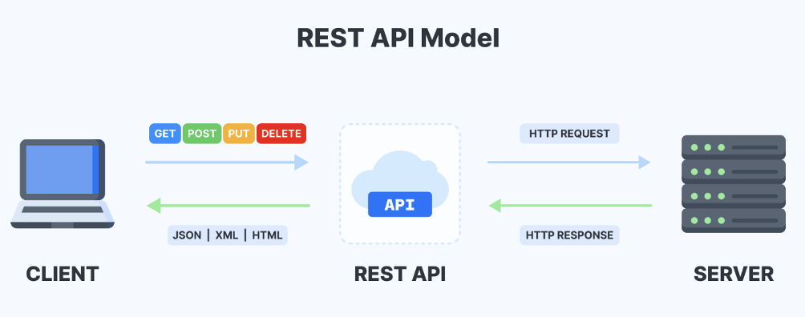
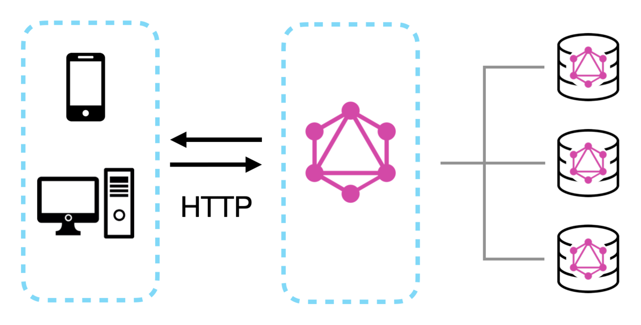
Understanding APIs
Definition: APIs (Application Programming Interfaces) allow different software applications to communicate with each other.
Types of APIs:
REST (Representational State Transfer)
GraphQL (Graph Query Language)
Common API Methods:
GET – Retrieve data
POST – Send new data
PUT – Update existing data
DELETE – Remove data

Slide 15
API ning mohiyati
API (Application Programming Interface) — bu dasturlar (yoki ilovalar) bir-biri bilan "suhbatlashishi" uchun yaratilgan qoida va vositalar to‘plami. Oddiy qilib aytganda: frontend va backend o‘rtasidagi ko‘prik yoki "ofitsiant".
REST (Representational State Transfer) Eng keng tarqalgan va klassik API turi.
Resurslarga (users, posts, products) URL orqali murojaat qilinadi.
HTTP metodlari (GET, POST, PUT, DELETE) orqali harakat bajariladi.
Javob odatda JSON formatida keladi.
Stateless — har bir so‘rov mustaqil (oldingi so‘rovni eslamaydi).
Misol endpointlar:
GET /api/users — barcha foydalanuvchilarni olish
POST /api/users — yangi foydalanuvchi yaratish
GET /api/users/123 — 123-raqamli foydalanuvchini olish

Slide 16
API ga misollar
https://jsonplaceholder.typicode.com/
https://jsonplaceholder.typicode.com/posts
https://jsonplaceholder.typicode.com/photos

Slide 17
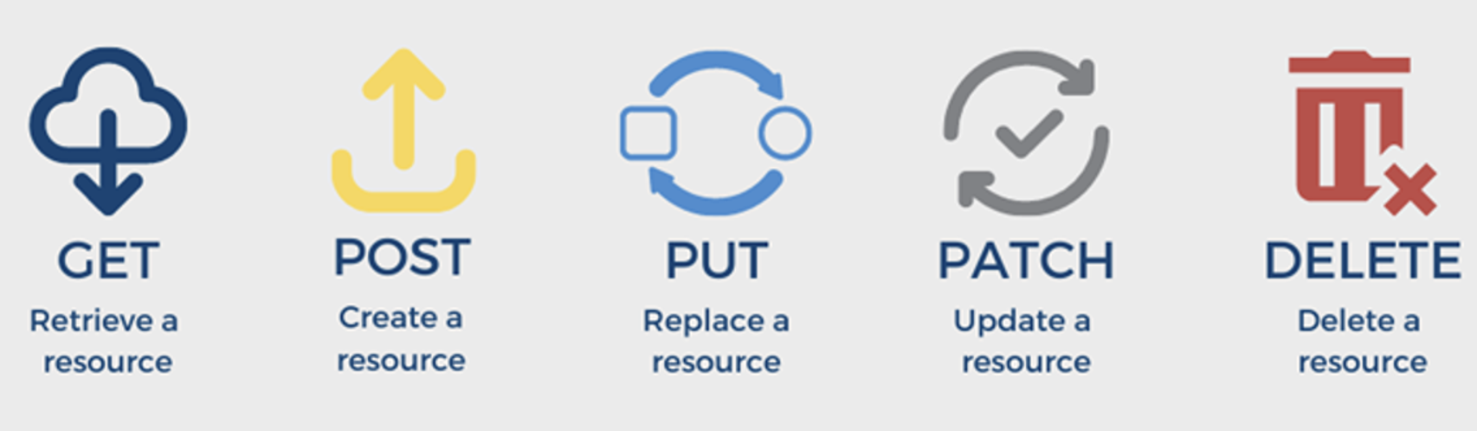
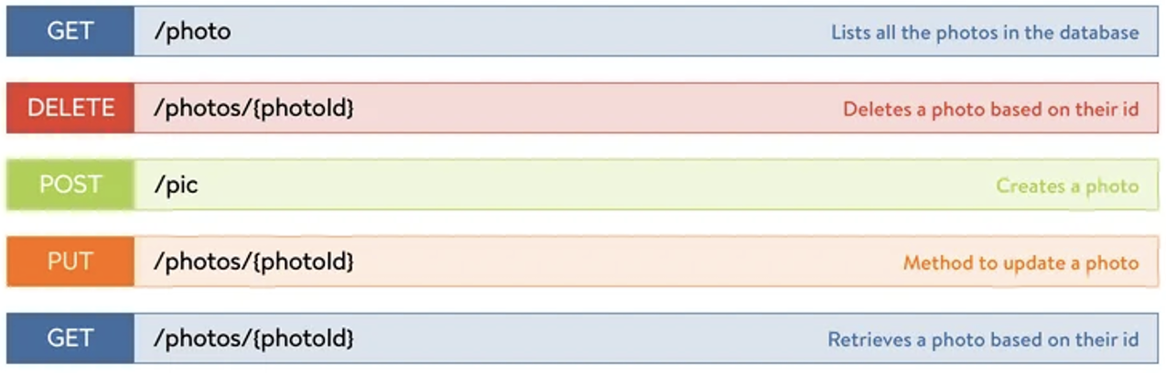
REST API methods

Slide 18


Sizga zo’r ilm olishingiz uchun, yaqindan yordam beradigan yagona inson – bu o’zingiz
Mustaqil o’rganish qobilyatlaringizni shakllantiring

Slide 19
Thank You

